Slide 1

Intro to Linux
brought to you by Gnulug.org

Slide 2
Intro to Linux Topics
Which Linux Distro (distros, package managers,
desktop environments)
Account Stuff (Logging in, useradd, passwd, su,
whoami, terminal control)
File system stuff (structure, cd, pwd, ls, abs and
rel referencing, mkdir, cp, find, locate, mcedit, cat, less
Other odds-and-ends (grep, man, info,
shutdown)
Notes:
Here is an outline of everything we will cover. We will start with account stuff.
‹#›

Slide 3
SLIDES AND SUPPLEMENTAL MATERIALS
gnulug.org/materials
PuTTY
the.earth.li/~sgtatham/putty/latest/x86/putty.exe
SSH
ssh NetID@linux.ews.illinois.edu

Slide 4

Linux is user friendly.
Its just very selective of its friends

Slide 5
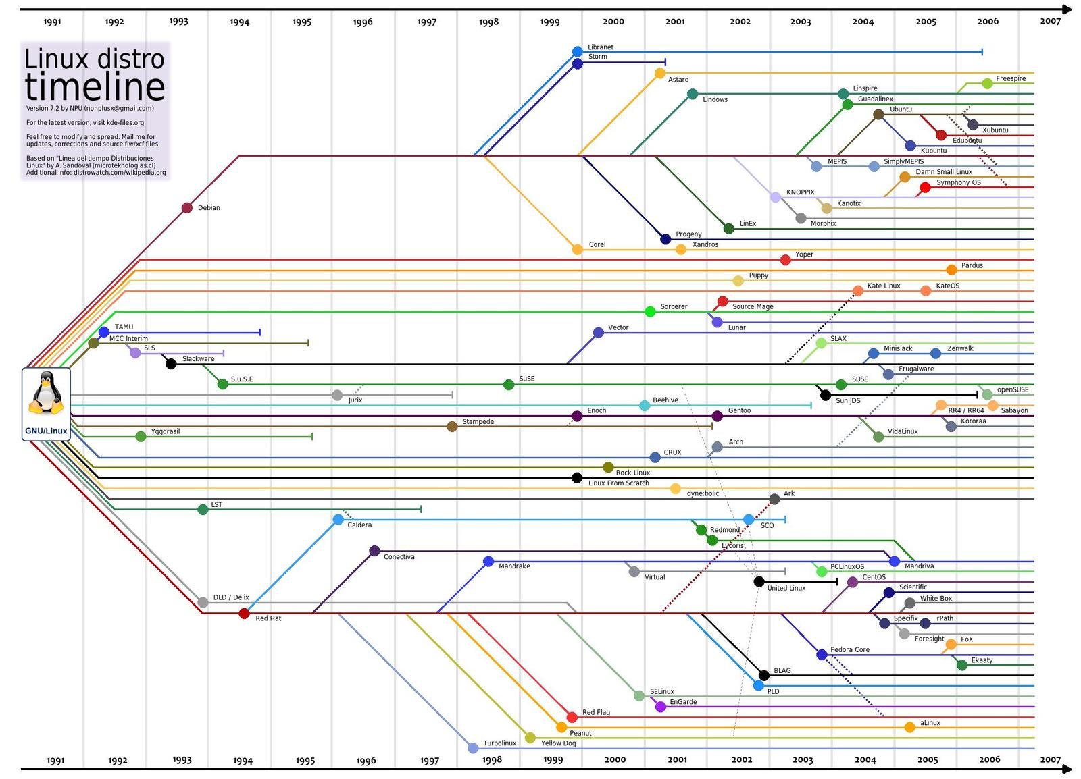
Source: http://www.saulycanada.com/assets/images/timeline.jpg
Notes:
Linux distro timeline (family tree)
probably a tenth of the entire list
why are there so many distros?

Slide 6
Popular Distros
Branch | Distros | Package Managers
Debian | Ubuntu | APT (Advanced Package Tool)
 | Kali Linux (BackTrack)
Red Hat | Scientific Linux | YUM (Yellowdog Updater, Modified)
 | CentOS
 | Fedora
Arch | Arch Linux | Pacman (Package Manager)
Enoch | Gentoo | Portage
Comprehensive List: https://en.wikipedia.org/wiki/List_of_Linux_distributions
Check out DistroWatch: http://distrowatch.com/dwres.php?resource=major
Notes:
Ubuntu - popular. many users.
Kali Linux - for digital forensics and penetration testing. metasploit, etc.
Scientific Linux - UIUC EWS. a distribution developed and maintained by research labs (Fermilab)
Arch Linux - advanced, fully customizable, great to learn linux by building up from a minimal base, rolling release
Gentoo - Long, not easy to install, advanced, fully customizable, great to learn linux
‹#›

Slide 7
Desktop Environments
GNOME
KDE (K Desktop Environment)
Unity
XFCE (XForms Common Environment)
LXDE (Lightweight X11 Desktop Environment)
MATE
Cinnamon
Pantheon
Notes:
‹#›

Slide 8
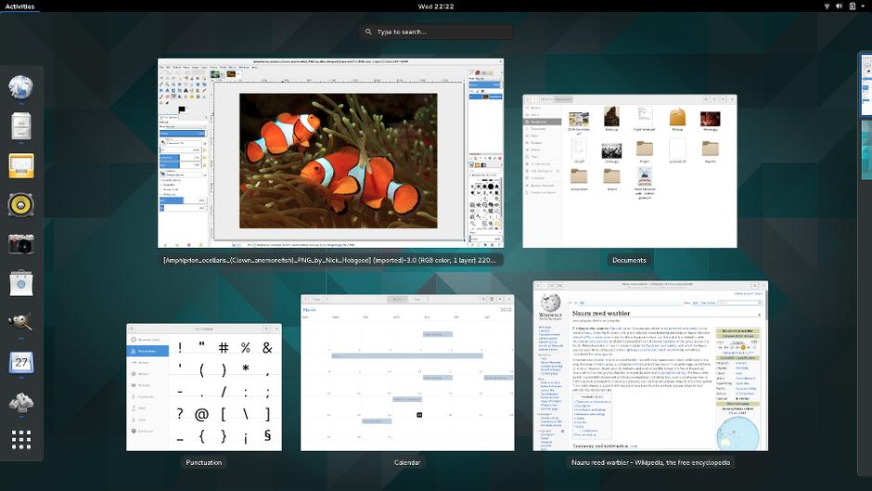
GNOME 3
Source: https://www.gnome.org/
Notes:
‹#›

Slide 9
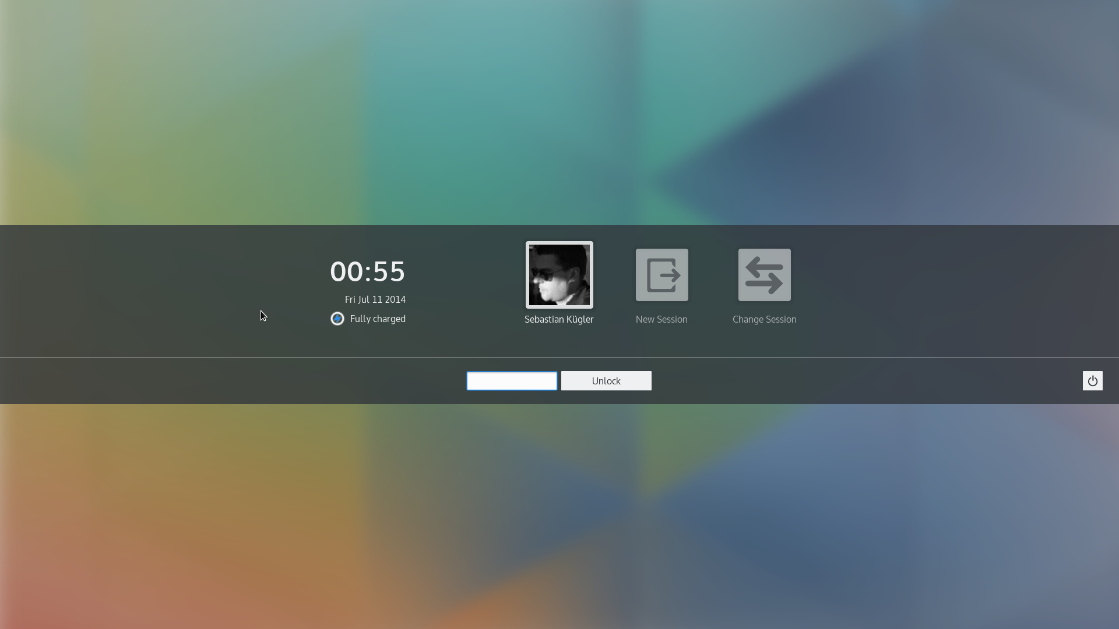
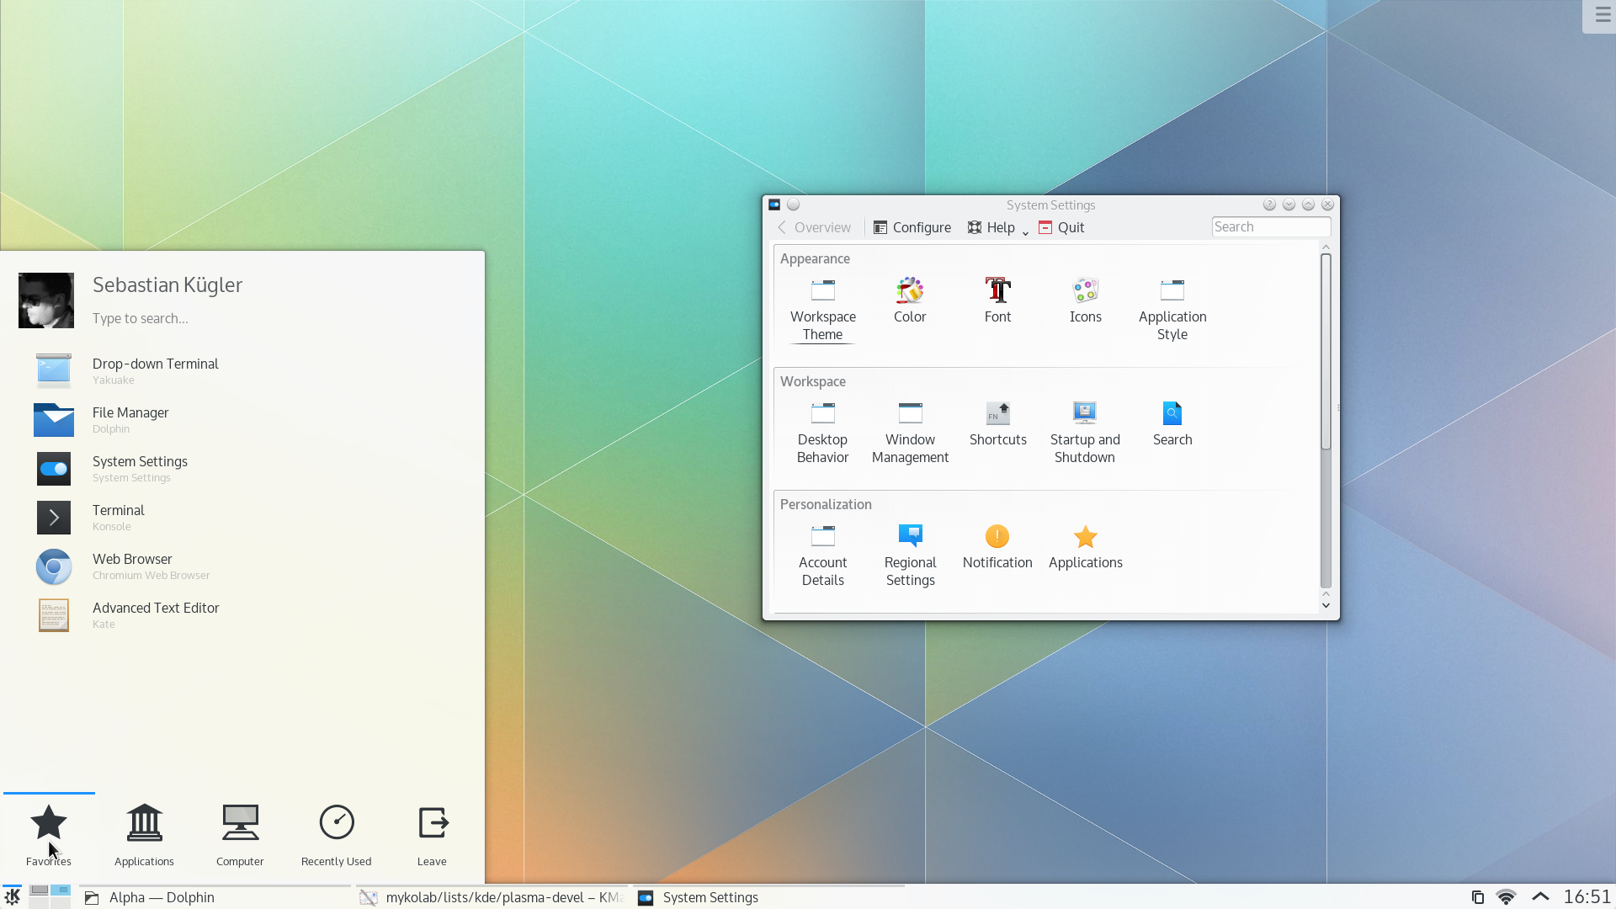
KDE (Plasma 5.0)
Source: https://www.kde.org/
Notes:
‹#›

Slide 10
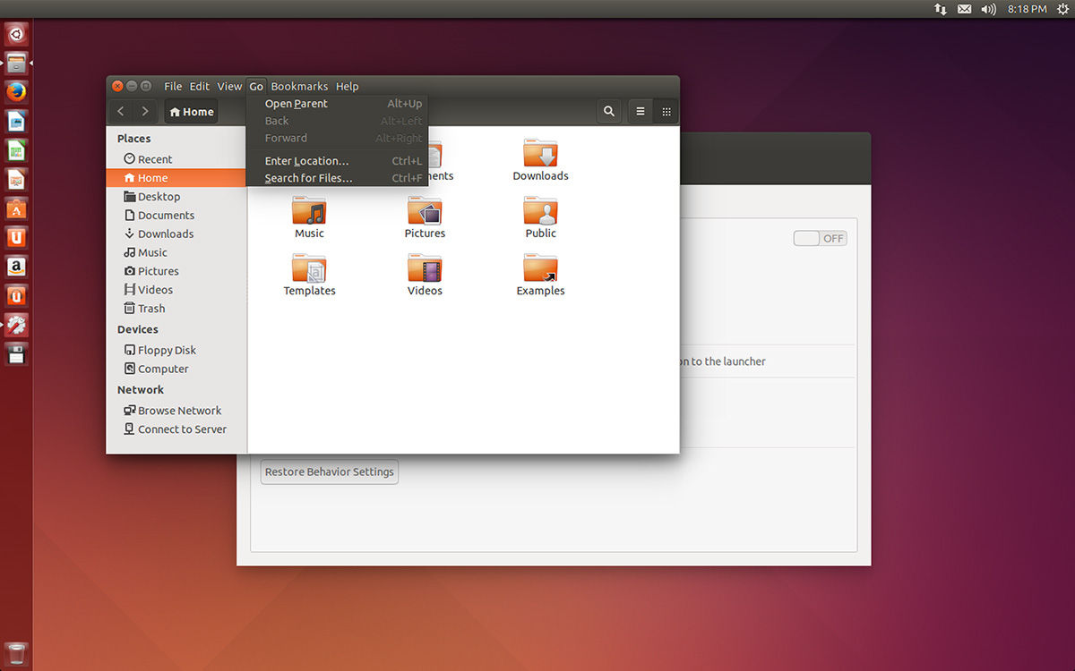
Unity
Source: http://www.theregister.co.uk/2014/03/28/ubuntu_14_01_final_beta_review/
Notes:
‹#›

Slide 11
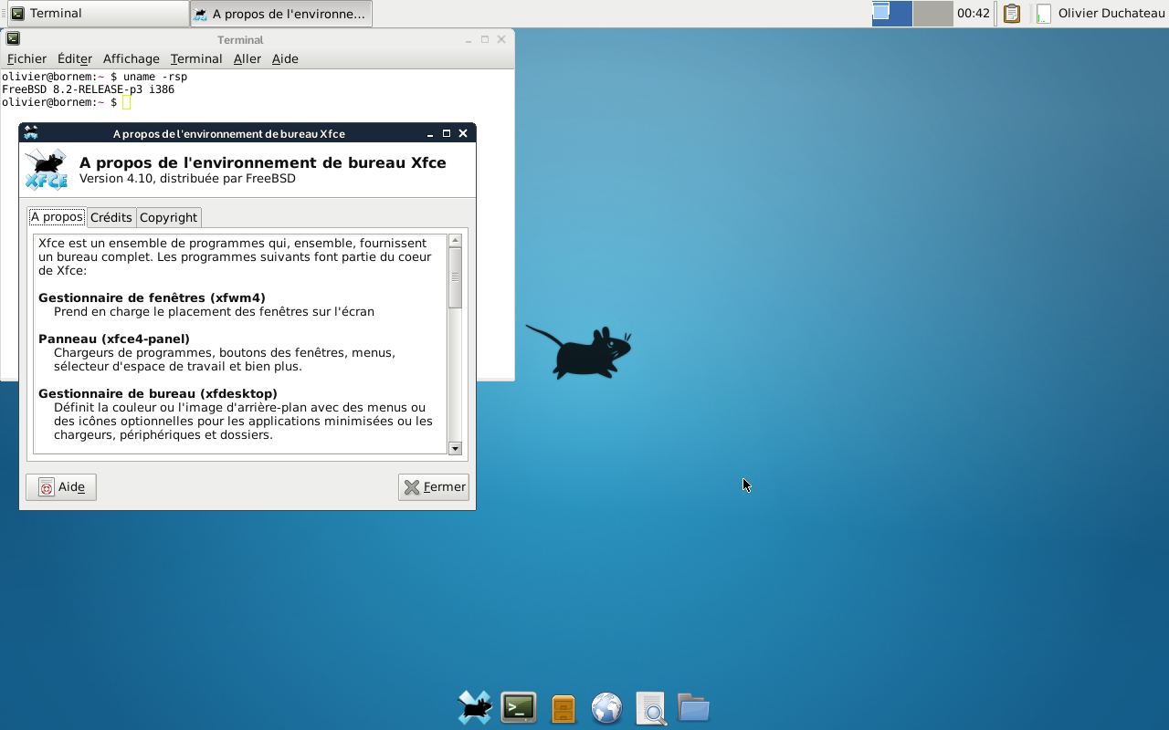
XFCE 4.10
Source: http://www.xfce.org/
Notes:
‹#›

Slide 12
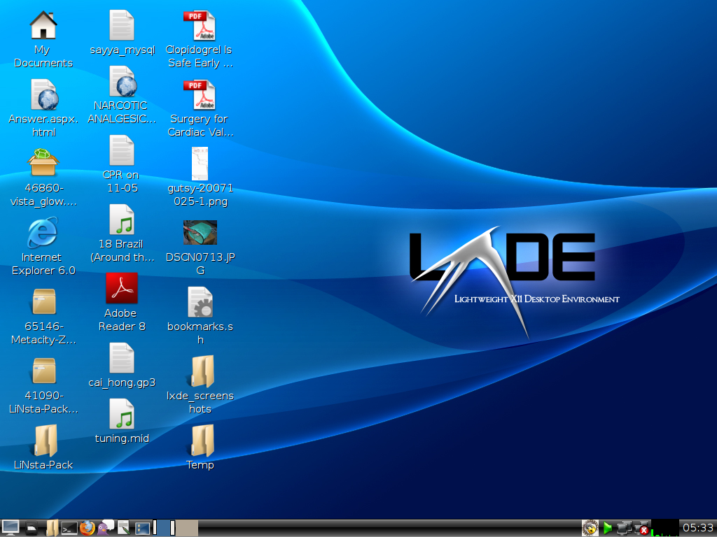
LXDE
Source: http://www.lxde.org/
Notes:
‹#›

Slide 13
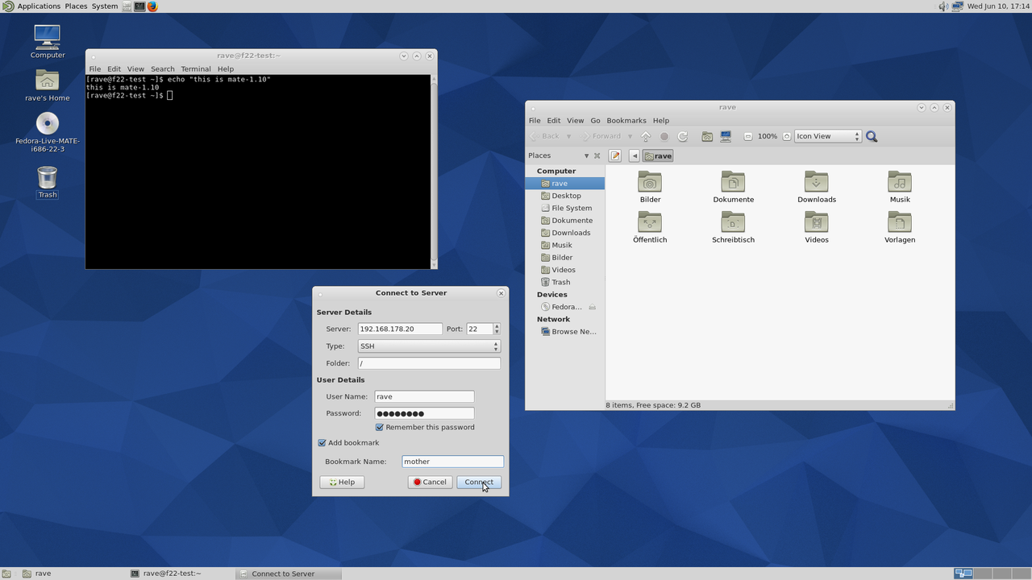
MATE 1.10
Source: http://mate-desktop.org/
Notes:
‹#›

Slide 14
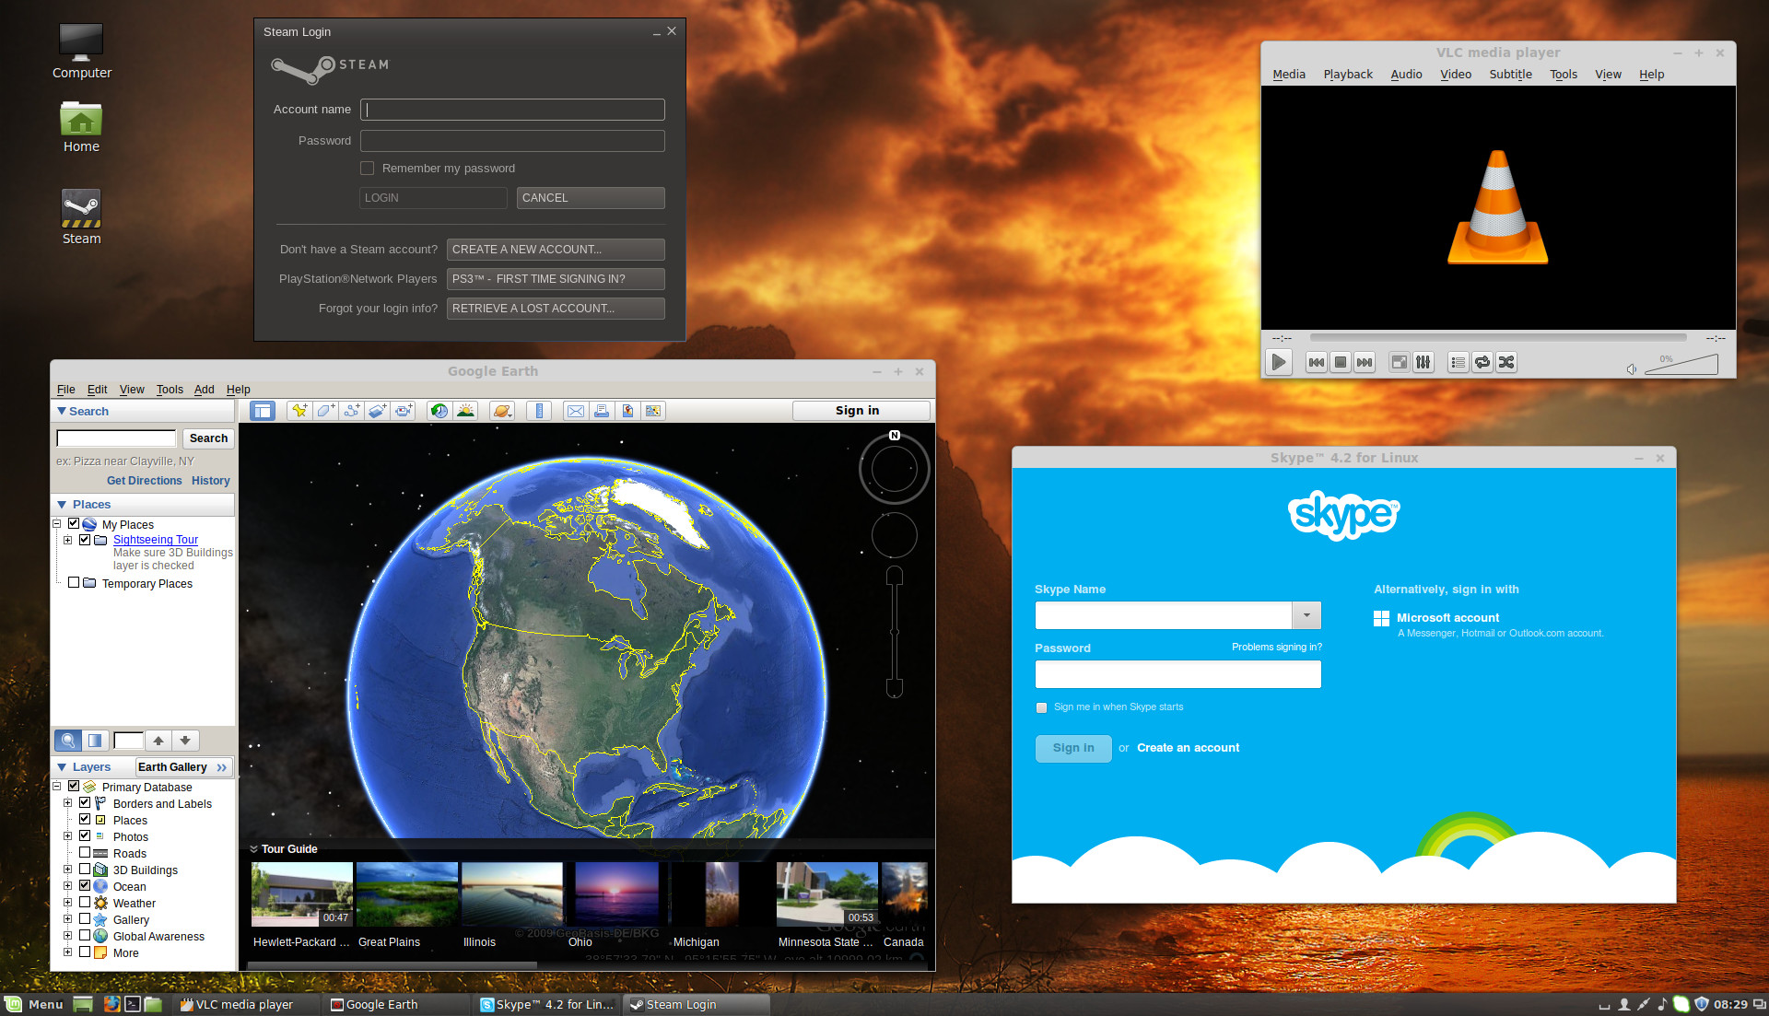
Cinnamon
Source: http://http://www.linuxmint.com/
Notes:
‹#›

Slide 15
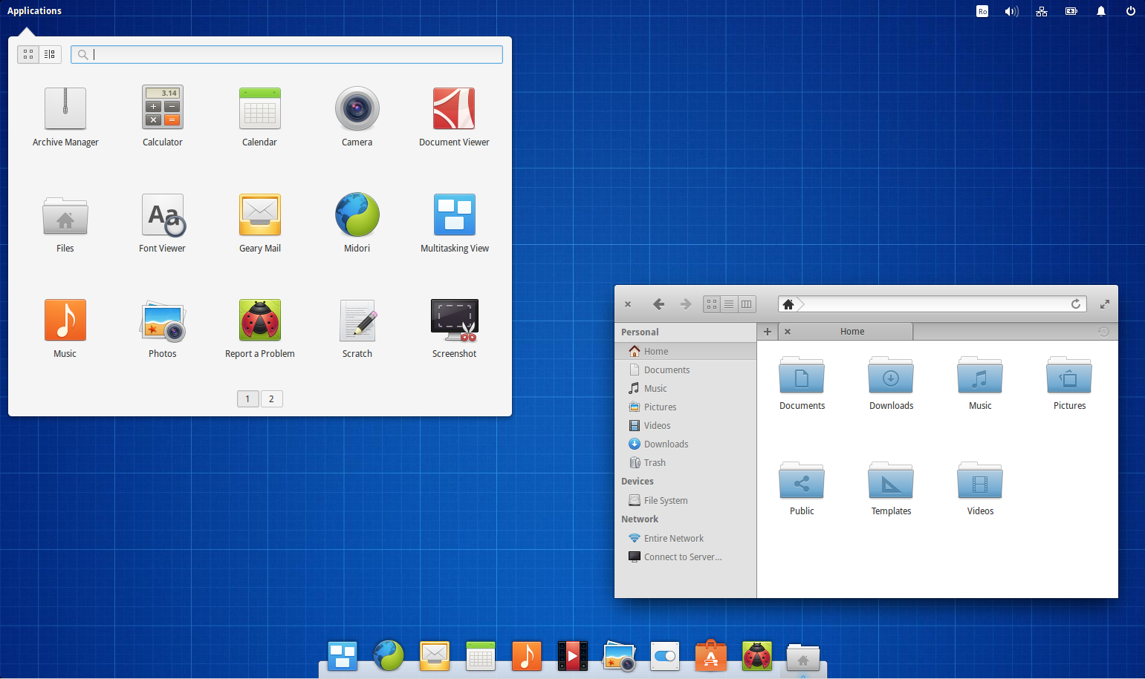
Pantheon (Elementary OS Freya)
Source: http://www.webupd8.org/2015/04/elementary-os-freya-available-for.html
Notes:
‹#›

Slide 16
Popular Ubuntu Variants
Ubuntu GNOME
Kubuntu
Xubuntu
Lubuntu
Linux Mint
Elementary OS
Notes:
‹#›

Slide 17





Free GNU/Linux Distributions
https://www.gnu.org/distros/free-distros.html
UIUC Virtual Linux Environment
Arch Linux with XFCE Desktop Environment
https://chara.cs.illinois.edu/sites/cs225/vm.html
Notes:
Free distros
UIUC VM for CS 2xx courses
“This VM does not exactly emulate the EWS environment, and does not inherently connect to the EWS environment.”
Intended to be backup system in case EWS machines are unavailable. Students are still responsible to check their codes on an EWS machine.
‹#›

Slide 18
You work from the prompt
It looks like this: (or similar)
bob@pc25 ~ $
bob username, the current user (you)
pc25 hostname, the whole machine’s name
~ The current directory you’re sitting in.
In this case, it’s ~, shorthand for your home
directory.
$ The prompt. You type a command here.
Notes:
Anatomy of the prompt
‹#›

Slide 19
Being Root vs. Non-root (useradd)
For almost all activities, you should log in as a
non-root user
Create a user by using the “useradd” command
# useradd –d [home_dir] [login]
“#” prompt means you are root
“$” or other prompt means you aren’t
User’s home directory is where that user is
placed after logging in. It also stores that user’s files.
Notes:
Go ahead and create a non-root account on your system
Keep an eye on your prompt
The login account “fred” will be created, with a home directory of /home/fred. The system will automatically assign a non-root userID to the account. The userID is just a number associated with this account for the purposes of assigning permissions. The home directory is where config files and other personal files for this account are stored.
‹#›

Slide 20
Changing Passwords (passwd)
The passwd command is used to change
passwords
Any user can type “passwd” to change his/her
own password
(The user is prompted for the new password twice.)
bob@pc ~ $ passwd
Or, to change any other user’s password, root
can type:
pc # passwd any_login_name
Notes:
Currently the fred account we created cannot be used because we haven’t yet set a password. The password isnt blank, the account is just disabled until we set a password. We need to set a password for the account by typing passwd fred
Fred can change their own password by typing passwd.
‹#›

Slide 21
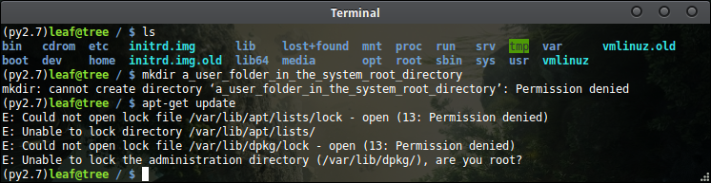
Use the root account sparingly!
Do everything as a non-root user, unless you must
use root for something! (The system will tell you.)
You can become root on your own machine, but on
a school- or company-owned system, you may not
have root access at all.
We’ll show you several ways to become root next.

Slide 22
Changing accounts the old way (su and whoami)
If you really need root, you can temporarily switch user with the su command. If no account name is given, root is assumed.
$ su [login_name]
[type login_name’s password]
The preferred way to get root is to use su with the “-” option to get the proper environment
$ su –
The command whoami shows which account you are currently using. exit returns to the normal user.
$ whoami
$ exit

Slide 23
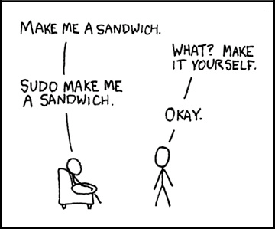
Changing accounts the new way (sudo)
Sudo is a way to temporarily
use root privileges without becoming root. (Safer!) You’ll be prompted for your password, but not multiple times in succession.
The user must be a member
of the “sudoers” group in order
to use sudo.
For example:
$ sudo apt-get update
https://xkcd.com/149/

Slide 24
Virtual Terminal Control (tty1-tty6)
If you don’t have a GUI, you can still access
multiple terminals with command prompts
Switch to various virtual terminals using the
Ctrl-Alt-Function keys:
Ctrl-Alt-F1 to switch to terminal 1
Ctrl-Alt-F2 to switch to terminal 2
Etc.. Up through Ctrl-Alt-F6
This probably doesn’t work if you’re
connecting remotely.

Slide 25
Linux file system structure
/ is the “root” directory of the system, not to be confused with the “root” account.
Notes:
/bin user binaries are stored here
/sbin System administrator binaries are stored here
/dev interface for system devices
/etc hold configuration items, like the account information (stored in /etc/passwd) and hashed passwords (stored in /etc/shadow)
/home contains user’s home directories
/lib contains common libraries
/mnt is where various remote and temporary file systems (cd-roms, floppies, etc.) are attached.
/proc is a virtual file system used to store general info
/tmp is for temporary data, and is usually cleared at reboot
/usr holds user programs and other data
/var holds many different items, including logs (/var/log)
‹#›

Slide 26
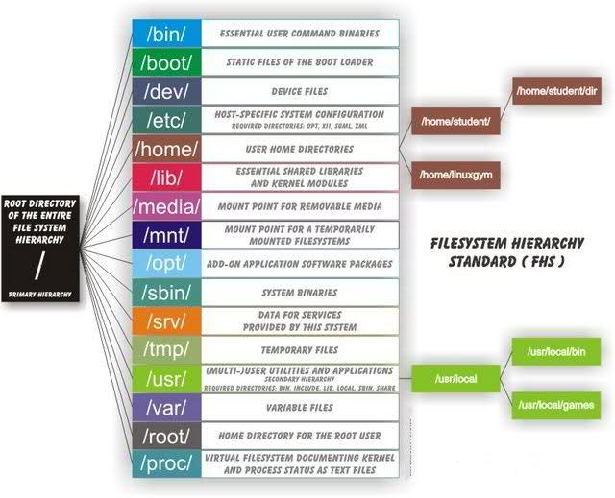

Slide 27
Navigating the File System (cd and pwd)
To see where you are, use the pwd command
(short for print working dir)
$ pwd
You can move around the file system using the cd
command.
$ cd [destination-directory-name]
The current parent directory (up one level) is called .. (two periods). This goes up one level:
$ cd ..
For comparison, the current directory is called . (one period).
Notes:
cd /
Pwd
What do you see?
cd ~
Pwd
What do you see?
‹#›

Slide 28
Navigating the File System (More tips)
Linux is case sensitive, so Stuff.txt and stuff.txt are different files. Windows and Mac don’t usually work like that, so be careful on shared drives.
The user’s home directory is actually /home/[username], but a synonym for it is ~
So you can go to your home directory with cd ~
You can also automatically jump there by entering cd by itself!
Two ways to deal with files or paths that contain spaces:
“Escape” the spaces with \ before each space:
$ cd /Volumes/Machine\ HD/
or enclose everything in quotes:
$ cd "/Volumes/Machine HD/"
Notes:
cd /
Pwd
What do you see?
cd ~
Pwd
What do you see?
‹#›

Slide 29
Absolute vs. relative file references
You can refer to files with their full path in the file system: absolute referencing, where everything starts with the “/” system root or the “~” home shortcut:
$ cd /etc/sysconfig/network-scripts
$ pwd
$ cd ~/Documents ← The ~ shortcut is absolute!
Or you can refer to files relative to your current working directory (everything starts assuming where you are currently located; don’t put / at the beginning!)
$ cd /etc ← Absolute!
$ cd sysconfig/network-scripts ← Relative!
$ pwd

Slide 30
Listing the directory contents (ls)
The ls command shows directory or file details
By itself, shows regular files. But some configuration files are hidden on purpose: their names start with a dot. Sometimes they’re called dotfiles.
With the -a option flag, ls -a shows all files
With the -l flag, ls -l shows long-form details (access permissions, timestamps, link destinations, etc.)
Combine them to get the full view:
$ ls –al
On some systems, ls applies various colors to certain file types. This can be convenient but don’t rely on it. The colors may vary, too.
Blue – directories
Green – executable (binary or script)
Red – compressed files (.tar, .gz, .tgz, .etc.)
Black/white – plain files
Notes:
If you are following along, type:
$ cd /etc
$ ls
What do you see?
$ ls –la
You now are looking at details associated with your /etc/ directory. System configuration is stored here. Note the differnet colors of the various files and directories.
‹#›

Slide 31
Making directories (mkdir)
To create a new directory, use the mkdir
command
Make a directory for your tools:
$ cd ~ ← go to home dir, “ ~ ”
$ pwd ← see where we are, really
$ mkdir tools ← create “ tools ” dir
(relative to where we are)
$ ls -la ← view all contents in ~

Slide 32


Slide 33
Copying Files (cp)
The cp command creates a copy of a file
$ cp [source] [destination]
To copy a bunch of files, you can use * to indicate all files in a given directory.
e.g. copy all files in ~/Documents to ~/Videos:
$ cp ~/Documents/* ~/Videos
To copy a whole directory as a directory, you need the -r recursive flag.
e.g. copy the Documents dir to ~/Videos,
which will be ~/Videos/Documents:
$ cp -r ~/Documents ~/Videos

Slide 34
Finding Files (locate and find)
You may need to find where a file is in your file system. The easy way to do this is the “locate” command, but it can’t find everything!
$ locate [program_name]
The “find” command exhaustively looks for stuff:
$ find [starting_where] [search_criteria]
Typically, your search criteria will be a name, and you’ll want to search your whole file system, so you can type:
$ find / -name [file_to_look_for]
For example, find the “whoami” program (may be slow!):
$ find / -name whoami
Or try finding something with “ch2” in the case insensitive name in your home dir… you can’t remember if it’s CH002 or ch2 or Ch_2:
$ find ~ -iname "*ch*2*"
Searching ~ is much faster than searching the whole system!
Notes:
‹#›

Slide 35
Creating and Editing files
Create empty files using touch (this will also
update the timestamp on an existing file) $ touch test_file.txt
Or just save a new file from within your text
editor.
There are many text editors that can run in
the terminal (vim, emacs, nano, pico, mcedit,
pick one!)

Slide 36
Accessing remote files
We all know how to download files from a browser
- just click a link.
wget - a computer program that retrieves files from web servers.
wget https://some.domain.com/coolcat.png
curl - a program that can interact with web servers by sending and receiving data
curl -L google.com

Slide 37

Viewing File Contents (cat)
The “cat” command shows the contents of a
file by dumping it right into the terminal.
$ cat /etc/passwd
$ cat /etc/fstab
$ cat ~/test_file.txt
$ cat /proc/meminfo
$ cat /proc/version
Sadly named after “concatenate”

Slide 38
Viewing Output (less)
Often you will need to view output that is larger than a
single screen. To view it more easily, you can send the
output through the less command
less lets you scroll up and down using arrow keys,
PgUp, PgDn, Home, End. Type q to get out of the viewer.
$ less test_file.txt
$ less /proc/meminfo
The vertical bar | character (the pipe) will “pipe” the output from another command into less:
$ ls /dev ← too much output?
$ ls /dev | less ← shows up inside less
Notes:
‹#›

Slide 39
Searching inside text files or piped output (grep)
The “grep” command finds text items that match a given condition. It finds text inside files.
$ grep [options] [pattern] [files]
To find files in the current directory that contain the word “root”, type: $ grep root *
Read this as “grep” for the string “root” from “star.” The “*” means all files in this directory.
You can supply options like -i for case insensitive search or -e for a regular expression search (more advanced).
$ grep -ie foo.*bar * ← finds “FOODBAR”

Slide 40
Using grep with netstat and ps
To see if anything is listening on port 7777,
you could type:
$ netstat –na | grep 7777
To see if you have any processes named
“bash” running, you could type:
$ ps aux | grep bash
“ps aux” isn’t “ps -aux” because of historical differences between BSD and *NIX. People confuse this all the time.

Slide 41
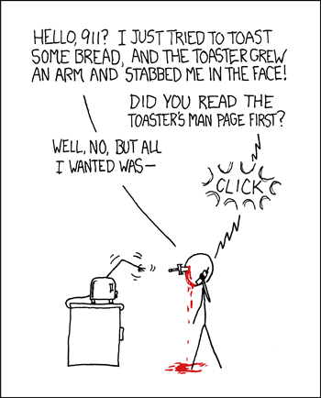
To learn more (man and info)
The “man” and “info” commands show detailed usage information for other commands,
for example: $ man ls
$ info ls
$ man man
Arrow keys to navigate, q to quit.

Slide 42
Getting hints from whatis
If you don’t want to look through an entire man page, and just need a hint about what a program does …
$ whatis [command]
As in:
$ whatis ifconfig
Notes:
‹#›

Slide 43
…More…
!! - repeats last command
history - view previous commands
Ctrl+C – terminates running command
clear – clears the window
(control+L does as well)
ifconfig – shows network interface info
file - Tells you the file type
Arrow keys up/down - put a command from
history on the prompt
Tab to complete typing (doesn’t always work if
you don’t have permissions)

Slide 44
…And more...
hostname – shows computer’s name
rmdir – remove directory (must be empty)
rm – remove a file (don’t do sudo rm -rf /*)

Slide 45

System Info
Get hostname for <ip>
# nbstat -A
Current username
# id
Logged on users
# w
User information
# who -a
Last users logged on
# last -a
Show list of users
# getent passwd
Show OS info
# cat /etc/issue
Show OS version info
# cat /etc/*release*
Port reference
# cat /etc/services

Slide 46
Shutting Down (and Reboot)
You can do this via the GUI or at a command
line
To shutdown and halt the system, type (as
root):
# shutdown –h now
To shutdown and reboot the sytem, type (as
root):
# shutdown –r now
Or, just type
# reboot

Slide 47
Remote Connections with SSH
SSH (Secure Shell)
Clients connect to servers (ssh)
Servers listen for incoming connections (sshd)
Connect to a remote server
$ ssh cs498a.cs.illinois.edu
Specify a user at run time
$ ssh demo@islet1.gnulug.org OR
$ ssh islet1.gnulug.org –l demo

Slide 48
Challenge #1
Make a GUI interface using Visual Basic to try to track their IPs

Slide 49
Challenge #2
Hack into the mainframe of Setec Astronomy and download the blueprints for encryption cracking device.
Notes:
https://www.youtube.com/watch?v=URVS4H7vrdU

Slide 50
Challenge #3
Hack the Gibson

Slide 51
More Info
GLUG - GNU/Linux & Unix Group http://www.gnulug.org/
Man pages - http://linux.die.net/man/
Unix & Linux Stack Exchange - http://unix.stackexchange.com/
The Linux Command Line: A Complete Introduction http://smile.amazon.com/Linux-Command-Line-Complete-Introduction/dp/1593273894/
How Linux Works: What Every Superuser Should Know
http://smile.amazon.com/How-Linux-Works-Superuser-Should/dp/1593275676

Slide 52

Credits
Original slides - Wayland Morgan
Other content - Shane Rogers, Simon Kim
More presenting - Will Song, Simon Kim
Additional slide editing - Eric Huber
Cat in blanket - Jelly (courtesy of Amarin Phaosawasdi)

